Slide 1
Global Healthcare Data ETL & Analysis CLI
Name : Thoutam Nikhil
Email : thoutamnikhilhara@gamil.com
Technology : Microsoft fabrics

Slide 2
Table Of Content
Project Overview
Objective
Technology Stack
Architecture Diagram
ETL Pipeline
Data Loading & CLI
Database Design
Testing & Validation – ETL Pipeline
Sample Queries & Analysis
Conclusion

Slide 3
Project Overview
This project focuses on building a robust command-line application for extracting, transforming, and loading (ETL) healthcare data. It emphasizes data engineering skills, including data ingestion, cleaning, and storage for analytical purposes.
Load data for any date range
Run analytical queries (e.g., daily trends, top vaccinated countries)
View or manage database tables
Data Extraction
Connect to public APIs and fetch raw healthcare data.
Data Transformation
Clean and structure data into a usable format.
Data Loading
Load processed data into a MySQL database.
Data Analysis
Perform queries and generate reports directly from the CLI.

Slide 4
Objectives
This project offers comprehensive learning across several key areas of data engineering and software development.
API Interaction: Master interacting with RESTful APIs for data extraction.
Data Transformation: Implement robust data cleaning and transformation techniques using Python.
Database Management: Design and manage relational database schemas in MySQL, optimizing data loading performance.
CLI Development: Build a user-friendly and functional command-line interface.
Data Analysis: Perform basic data analysis and reporting using SQL queries.
Robustness: Implement logging and error handling for data pipeline robustness.

Slide 5
Technology sparks
(1) Python Core language for implementing ETL logic, API interaction, and CLI development.
(2) MySQL Relational database used to store transformed healthcare data for analysis.
(3) argparse Python libraries used to build the interactive and user-friendly command-line interface.
(4) Requests For fetching data from public healthcare APIs via HTTP requests.
(5) pandas Used for data cleaning, transformation, and preparation before loading.
(6) Logging Implemented to monitor ETL steps, handle errors, and ensure pipeline reliability.

Slide 6
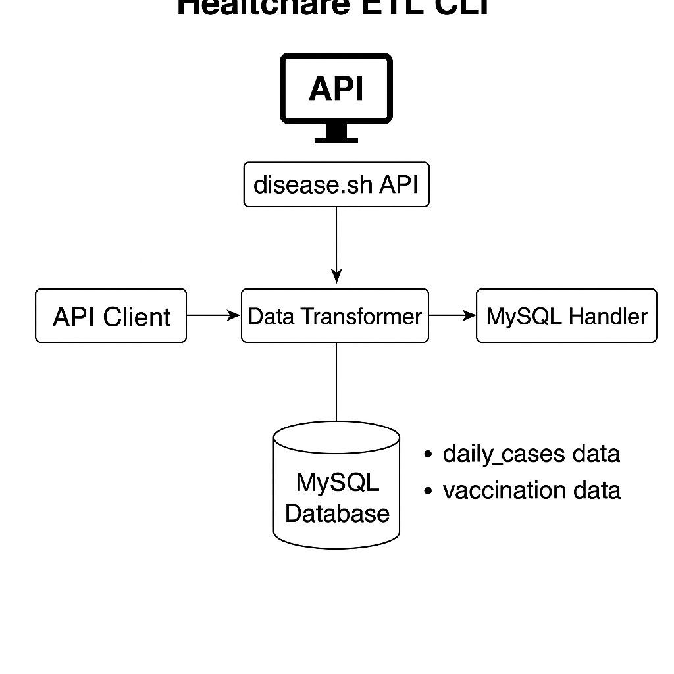
Architecture Diagram

Slide 7
ETL Pipeline The core of this project involves building a robust ETL pipeline with specific functionalities for data handling
Data Transformation (T)
Parse JSON/XML into structured Python format.
Perform data cleaning (missing values, types, duplicates, standardization).
Apply business logic transformations (e.g., calculating daily new cases).
Define and enforce a target data schema for MySQL.
Data Extraction (E)
Connect to a public healthcare API
(e.g., WHO, CDC).
Handle API authentication and rate limits.
Fetch data based on user-defined parameters.
Gracefully handle API errors and network issues.
The pipeline must ensure data integrity and efficient processing from source to destination.

Slide 8
Data Loading & CLI Beyond ETL, the project requires efficient data loading into MySQL and a user-friendly command-line interface for interaction and analysis.
Data Loading (L)
Establish connection to MySQL database.
Create necessary tables with appropriate data types and keys.
Implement efficient batch insertion of transformed data.
Handle incremental loads (insert new or update existing records).
Implement error handling for database operations.
CLI Interface & Data Analysis
Develop CLI using argparse or Click.
Commands for: fetch_data ,list_tables ,query_data ,drop_table .
Display query results in readable tabular format.

Slide 9
Database Design MySQL table , daily_cases illustrate the required schema design for storing healthcare data.
Column | Data Type | Description
Id | INT (PK) | Auto-incremented unique ID
report_date | DATE | Date of the data report
country_name | VARCHAR | Country name
total_cases | BIGINT | Total cumulative cases to date
new_cases | INT | New cases on that day
total_deaths | BIGINT | Total cumulative deaths
new_deaths | INT | New deaths on that day
etl_timestamp | TIMESTAMP | Auto-set timestamp when data inserted

Slide 10
Database Design MySQL table , vaccination_data illustrate the required schema design for storing healthcare data.
Column | Data Type | Description
id | INT (PK) | Auto-incremented unique ID
report_date | DATE | Date of the data report
country_name | VARCHAR(255) | Country name
total_vaccinations | BIGINT | Total vaccinations till that date
etl_timestamp | TIMESTAMP | Auto-set timestamp when data inserted

Slide 11
Testing & Validation – ETL Pipeline
ETL Process Testing
(1) API Client:
Verified data fetching with valid and invalid inputs.
Tested for API downtime, invalid URLs, and rate limiting.
(2) Data Transformation:
Handled missing values, wrong data types, and duplicates.
Ensured data aligned with the defined MySQL schema.
(3) MySQL Data Loading:
Tested initial and incremental data loads.
Verified primary key constraints and timestamp correctness.
Checked for duplicate prevention.

Slide 12

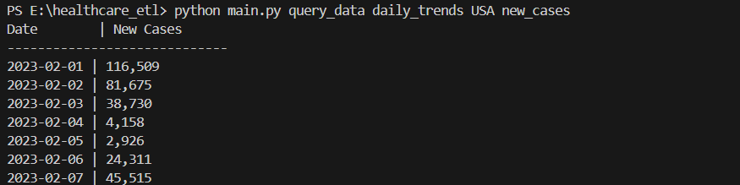
Sample Queries & Analysis
(1) python main.py list_tables
(2) python main.py fetch_data country INDIA 2020-03-01 2020-03-31
(3) python main.py query_data total_cases India
(4) python main.py query_data daily_trends INDIA new_cases

Slide 13
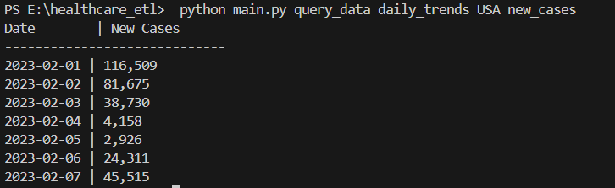
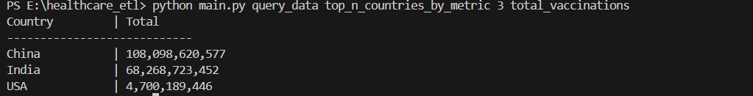
Sample Queries & Analysis
(4) python main.py query_data daily_trends USA new_cases
(5) python main.py query_data top_n_countries_by_metric 3 total_vaccinations

Slide 14
Conclusion
Successfully built a CLI-based healthcare data pipeline
Automated extraction, transformation, and loading of real-world COVID-19 data
Enabled quick insights through interactive queries
Scalable design for analytics, reporting, and future features

